Slide 1

Electrical Machinery Fundamentals
EE 250 SPRING 2020
Lecture 7
1

Slide 2
Chapter 11 Special Transformers

Slide 3
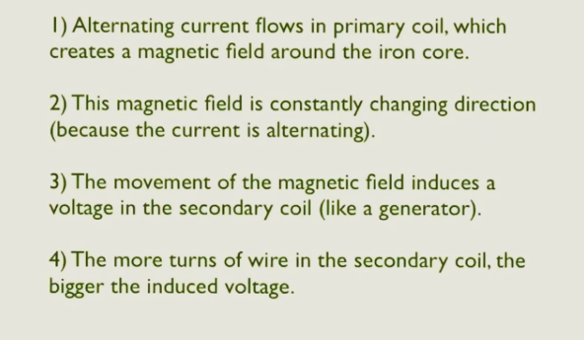
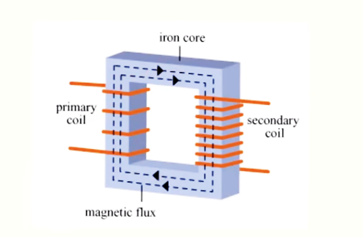
Transformer Basics

Slide 4
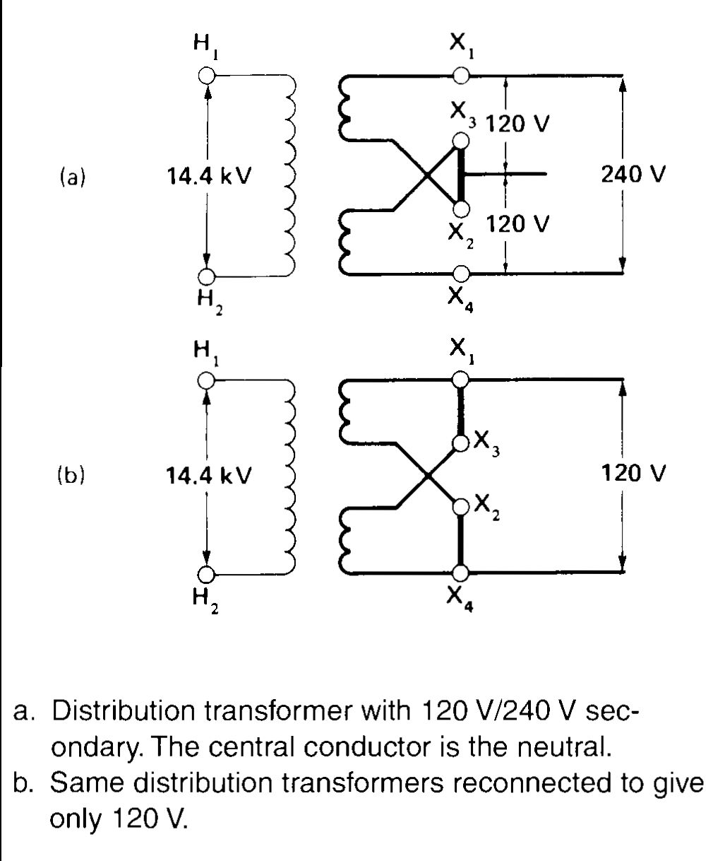
11.1 Dual-voltage distribution transformer
Residential transformers generally have two secondary windings (in series) with total line voltage of 240 V
Central tap called neutral is connected to ground along with H₂ (primary winding)
Characteristics:
Nominal rating ranges from 3kVA to 500kVA
Mounted on poles
Supply power to approx. 20 customers
Load on distribution transformer varies depending upon demand
When load peaks occurs? Power peaks less than 1 or 2 hours and for rest of day transformer operate far below their normal rating
Efforts are made to keep the no-load losses small => Low-loss silicon-steel in the core

Slide 5
11.1 Dual-voltage distribution transformer

Slide 6
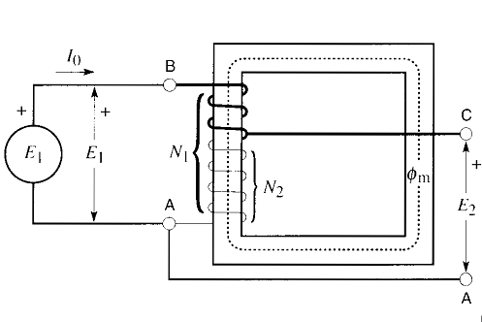
11.2 Autotransformer
In such a transformer secondary winding is a part of primary winding and there is no need of separate secondary winding
Benefits: Smaller, lighter and cheaper than standard transformer of equal output power
Drawback: Absence of electrical isolation between primary and secondary
Single transformer winding having N₁ turns on an iron core
Winding connected to fixed AC voltage source E₁ and exciting current I_{o} creates an AC flux Φ_{m} in iron core
Tap C is taken off the winding => N₂ turns between C and A
As induced voltage is proportional to the no. of turns, so:

Slide 7
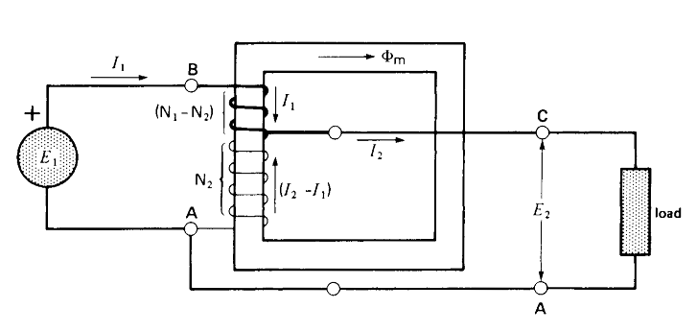
11.2 Autotransformer
Primary voltage E₁, Secondary voltage E₂
Primary terminals B,A and Secondary terminals C,A are no longer isolated from each other because of common terminal A
Resultant current I₂ upon load connection across secondary terminal causes primary current I₁ to flow
BC portion carries current I₁ and according to KCL CA portion carries (I₂ – I₁) and also mmf due to I₁ and (I₂ – I₁) must be equal and opposite and thus we have:
To transform when primary/secondary ratio is close to 1
=>

Slide 8
11.2 Autotransformer
Example 11.1
Assuming transformer losses and exciting current are negligible => Apparent power drawn by load=Apparent power supplied by source. So:
Applications:
Used to start induction motors
To regulate voltage of transmission lines
To transform when primary/secondary ratio is close to 1
=>

Slide 9
11.2 Autotransformer

Slide 10
11.3 Conventional transformer connected as an autotransformer
Conversion to autotransformer by connecting primary and secondary windings of conventional transformer in series.
Depending upon connections, secondary voltage can be added to or subtracted from the primary voltage.
Basic operation remains unchanged by changing connection

Slide 11
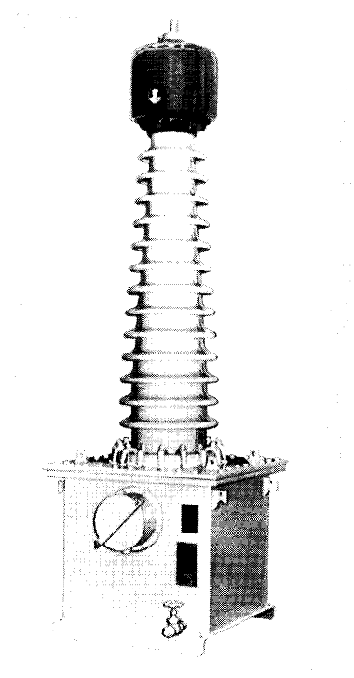
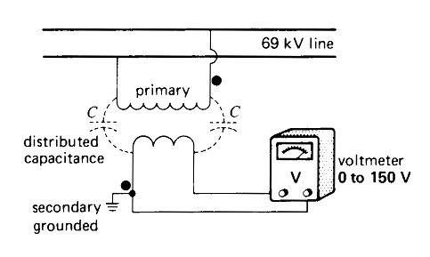
11.4 Voltage transformers
High-precision transformers in which ratio of primary voltage to secondary voltage is a known constant
Secondary voltage almost in phase with primary and nominal secondary voltage is usually 115V that permits standard instruments to be used on secondary side
Used to measure or monitor the voltage on transmission line and to isolate the metering equipment from these lines

Slide 12
11.4 Voltage transformers
Construction: Same as that of conventional transformer but insulation between primary and secondary must be great to withstand full line voltage on HV side
Distributed capacitance makes invisible connection between primary and secondary windings and thus produce very high voltage between S.W and ground
One terminal of S.W is connected to ground for safety from fatal shock and to limit the highest voltage between S.W and ground to a value of 115V
Voltage transformers are installed on HV lines to measure line-to-neutral voltage

Slide 13
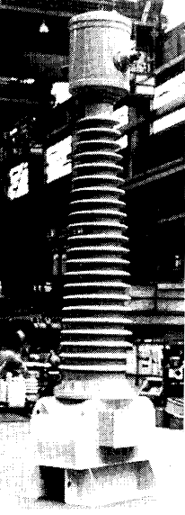
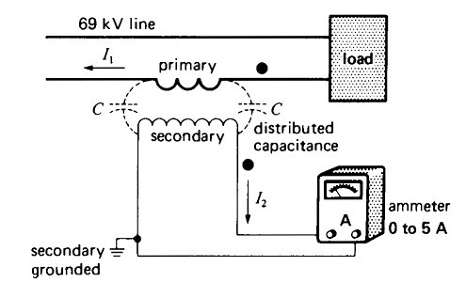
11.5 Current transformer
High-precision transformers in which ratio of primary to secondary current is a known constant with small change upon loading
Phase angle between primary and secondary current is usually much less than one degree
Used to measure/monitor the line current and to isolate the metering equipment from these lines
Nominal secondary current is usually 5A, irrespective of the primary current rating
Like conventional transformer, current ratio is inversely proportional to number of turn on P.W & S.W

Slide 14
11.5 Current transformer
For safety CT must always be used for measuring currents in HV transmission lines
Insulation between P.W & S.W must be great enough to withstand full line-to-neutral voltage
Maximum voltage that CT can withstand is mentioned on the nameplate
Like voltage transformer one S.W is always connected to ground
Example: Handheld current transformers

Slide 15
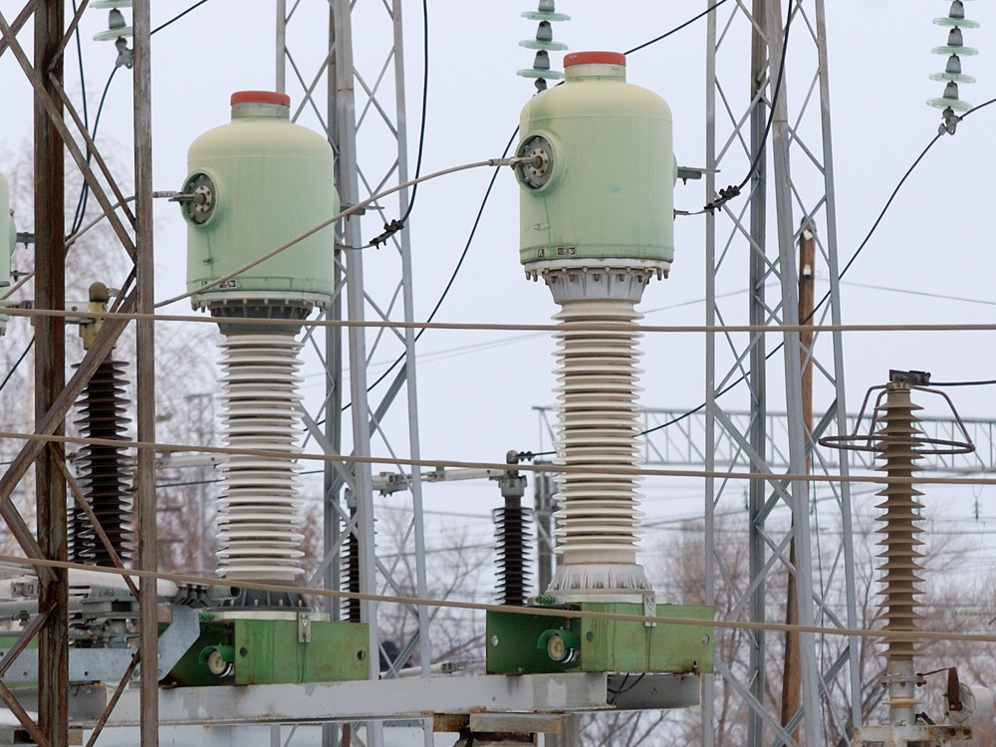
11.5 Current transformer

Slide 16
11.6 Opening the secondary of CT can be dangerous
Never open the secondary circuit of CT while current is flowing through primary circuit
Secondary of CT opened => Primary current flows unchanged because impedance of primary is negligible compared to that of electrical load
Due to open secondary there is no more bucking effect and thus line current becomes exciting current of transformer
Flux is so large that core is totally saturated for the greater part of every half cycle
From fig. as current rises or falls in first half cycle, flux Φ in the core also rises and falls but it remains at fix saturation level Φ_{s} for most of the time and same is the case for second half cycle
Dangerous situation for being getting shock

Slide 17
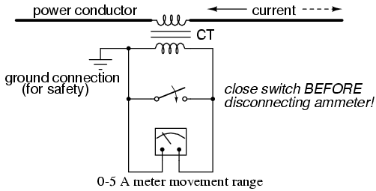
11.6 Opening the secondary of CT can be dangerous

Slide 18
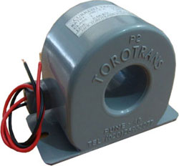
11.7 Toroidal current transformers
Consist of laminated ring-shaped core that carries secondary winding
Primary is composed of single conductor passing through center of S.W core
If secondary possesses N turns then ratio of transformation is N because primary consist of 1 turn
When line current exceeds 100A, we use totoidal transformer
Inexpensive and widely used in low-voltage and medium-voltage indoor installations
Applications:
Circuit-breaker

Slide 19
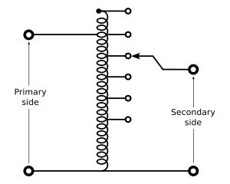
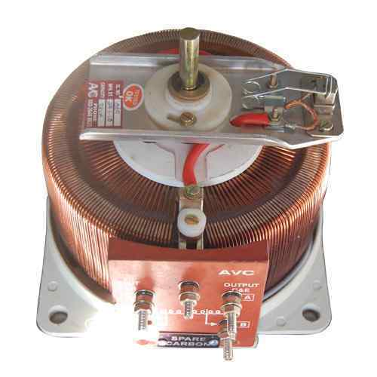
11.8 Variable autotransformer
Used when we wish to obtain variable AC voltage from a fixed source
Composed of single-layer winding wound uniformly on a toroidal iron core
Movable carbon brush serves as a variable tap
Brush position ranges from 0° to 330°
Secondary voltage depends upon the position of carbon brush
E₁ fixed connection to 90% tap => E₂ varies from 0 to 110%
Efficient and provide good voltage regulation under variable load
Secondary is protected by fuse so that I₂ must not exceed the current rating of the transformer

Slide 20
11.9 High-impedance transformers
Reactance is a form of opposition that electronic components exhibit to the passage of alternating current because of capacitance or inductance
Transformers that have been studied in previous slides have low leakage reactance (.03 to 0.1 per unit)
Industrial & commercial applications requires much higher reactance (up to 0.9 per unit)
Application of High-Impedance transformers:
Electric Toys:
Toy accidentally short-circuited
Neither practical nor safe to protect with fuse
Transformer design with high leakage reactance such that permanent short-circuit across low-voltage secondary will not cause overheating
Bell transformers that provide low-voltage signaling power to home, current is limited by high reactance in case of short-circuiting on secondary side

Slide 21
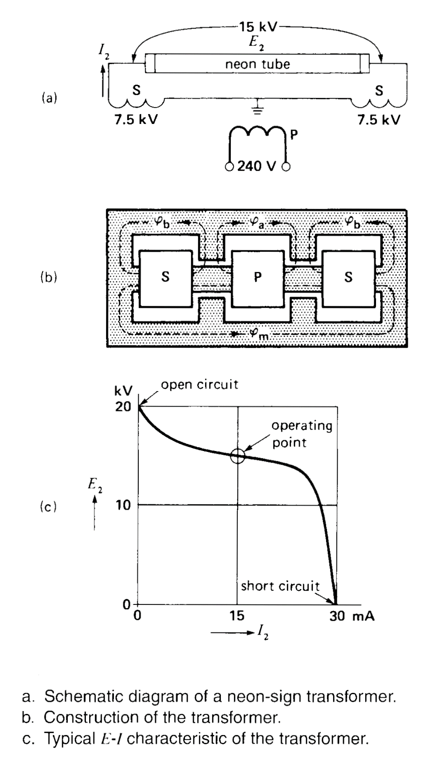
11.9 High-impedance transformers
Arc welders:
Negative E/I characteristics (=> When arc is struck, current increases as voltage falls) for electric arc furnaces & discharges in gases
Addition of impedance in series with load to maintain steady arc or uniform discharge
Series impedance:
Resistor
Reactor (Preferable as consumes little active power)
Economical to incorporate the reactance (high leakage reactance) in the transformer in case we wish to use transformer to supply the load
Example:
Neon sign transformer
P.W P
Two S.Ws in series with neon tube
Flux increase => Current increases => Voltage falls

Slide 22
11.9 High-impedance transformers
Electric Arc Furnaces:
Generates heat by maintaining intense arc between two carbon electrodes
Relatively low secondary voltage is used
Large secondary current is limited by leakage reactance of the transformer
Leakage reactance of secondary along with reactance of conductor must be sufficient to provide limiting impedance in large furnaces
Arc-welding transformers:
Have high leakage reactance to stabilize the arc during the welding process
Open circuit voltage (about 70 V) for striking arc
With established arc secondary voltage falls to about 15 V

Slide 23
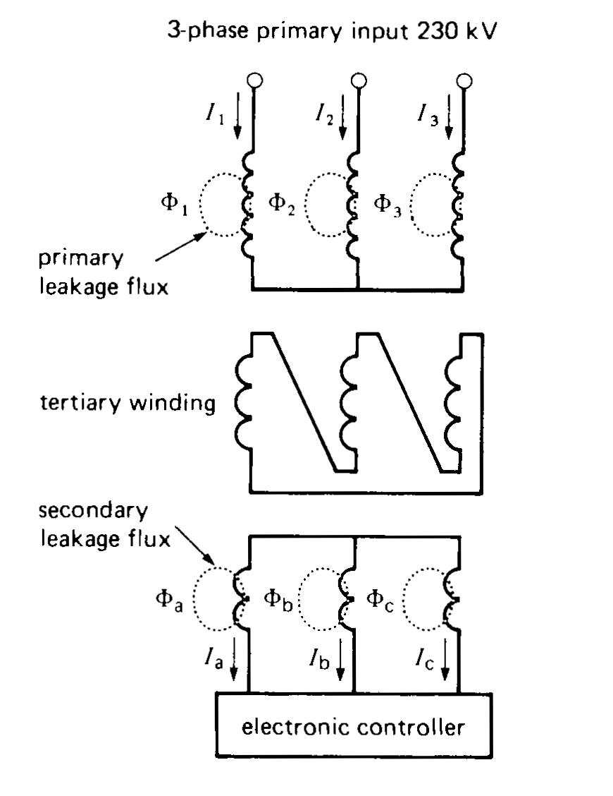
11.9 High-impedance transformers
Three-phase static var compensator:
Intentionally designed to produce leakage flux
Primary & Secondary are loosely coupled
P.W (230 to 765 kV) & S.W (typically 6kV)
S.W is connected to controller to control secondary current flow that results in varying the leakage flux accordingly

Slide 24
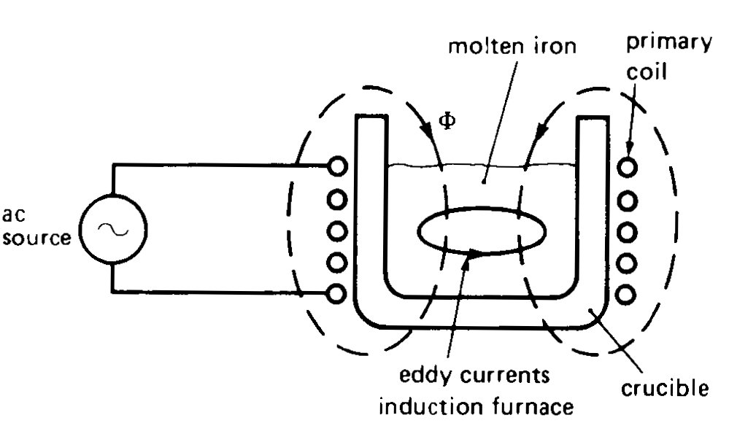
11.10 Induction heating transformers
High frequency (500 Hz) AC source connected to P.W that surrounds large crucible containing molten metal (S.W short-circuited upon itself and carries large secondary current)
Large current provides energy and keeps the metal in molten state
If source with high value is to be used then we lowers the frequency of source accordingly
Power factor of coreless induction furnaces is very low (about 20 %)
Reason:
Large magnetizing current requirement for driving flux through molten metal and air

Slide 25
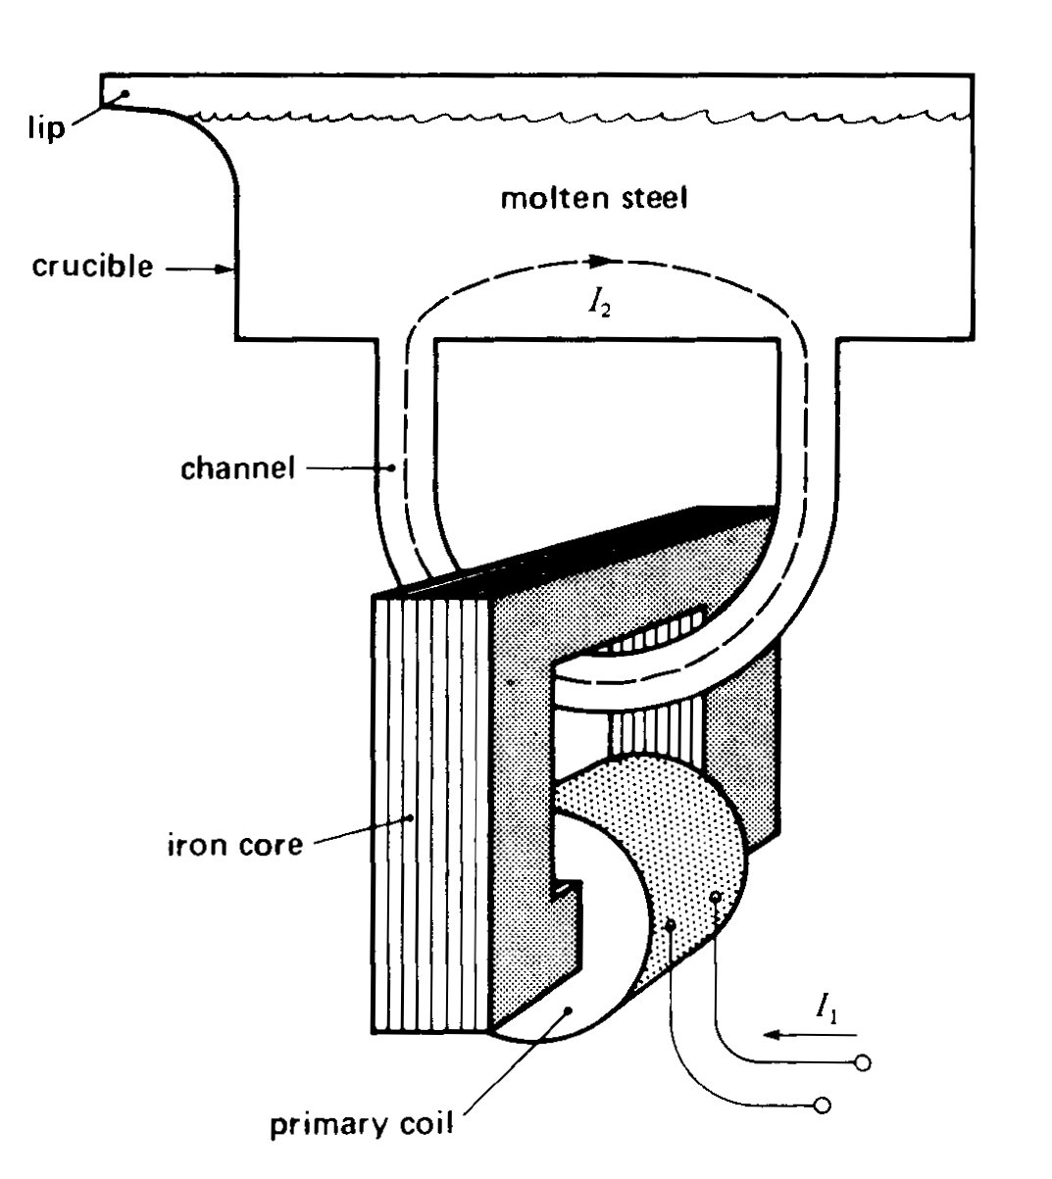
11.10 Induction heating transformers
Channel furnaces:
Having laminated iron core linked with channel of molten metal
Ceramic channel fitted at bottom of crucible
P.W is excited by 60 Hz source
Secondary current flows through molten metal
Channel is behaving as single turned secondary winding
Magnetizing current is low as flux is confined to highly permeable iron core
Leakage flux is large as P.W and S.W are not tightly coupled
Higher power factor (60 to 80%)

Slide 26
11.11 High-frequency transformers
Higher frequency helps us in reducing size of devices such as transformers, inductors and capacitors
Example: Practical transformer to understand the size variation with increasing frequency
Stepwise Sequence:
Raise frequency
Lower flux density due to increased losses
Raise flux density by introducing special core material
In order to maintain original voltage ratio of 120V to 24V we need to rewind the transformer and new primary and secondary turn will be 45 and 9 respectively, this can be calculated as:
Reduction in number of turns will result in increase of wire size
Capacity of transformer is still 480VA => Primary and secondary current must be raised to 4A and 20A respectively
Advantages:
Smaller, Cheaper, Efficient, Lighter than 60Hz transformer

Slide 27
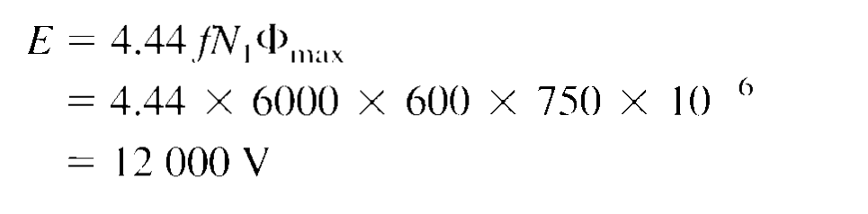
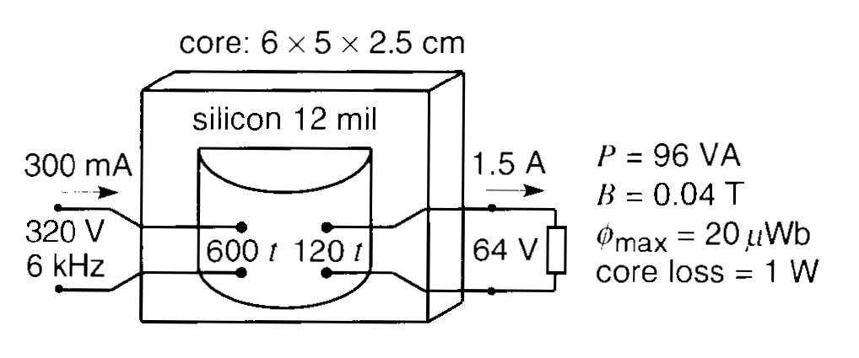
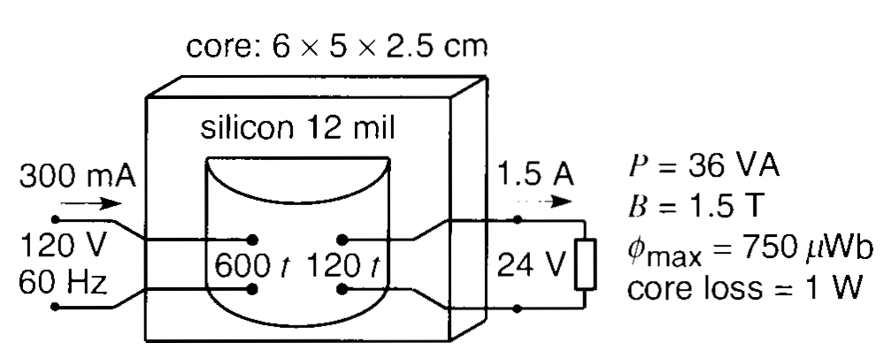
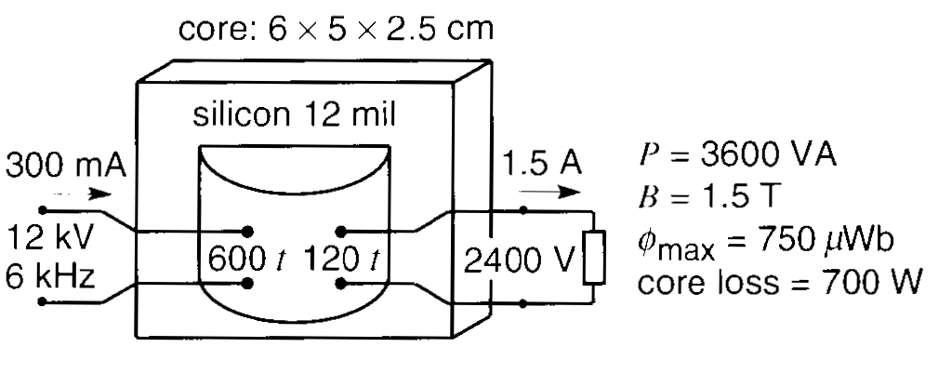
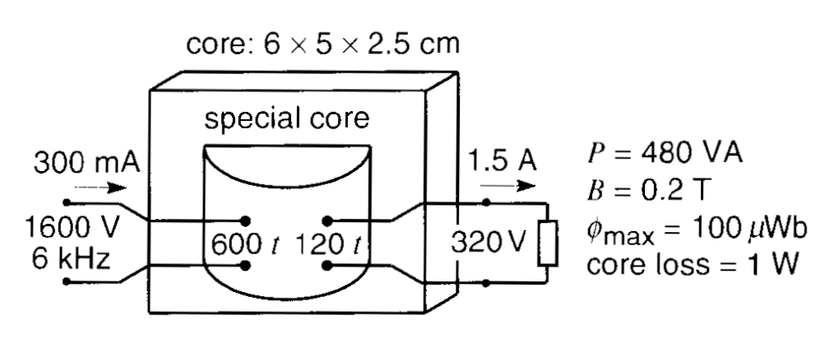
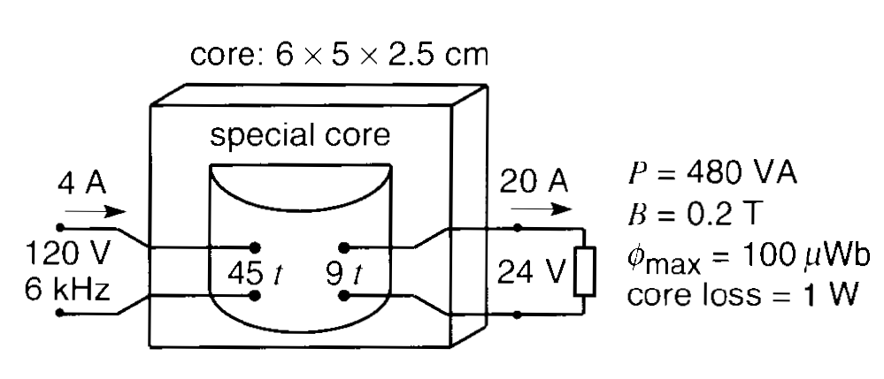
Special Nickle Steel Insulation
Peak flux will change as under by increasing
flux density from 0.04T to 0.2T:

Slide 28
Chapter 11 11.1-11.11 Examples: 11.1 & 11.3

